Slide 1
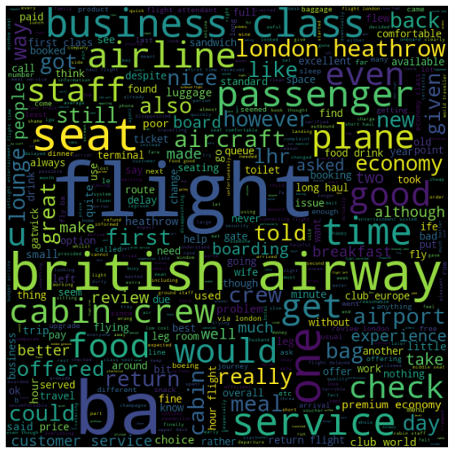
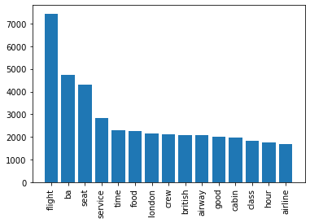
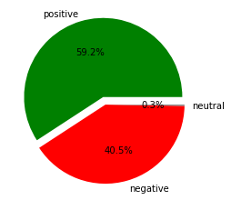
BRITISH AIRWAYS CUSTOMER REVIEWS ANALYSIS
Key Topics
The frequency chart and the word cloud show that the key topics within the reviews are “staff”, “seat”, “flight”, ”time” , ”cabin crew” and “service.” This shows that people are actively talking about their experience within the flight and the customer service.
Sentiment
Out of 3500 reviews, 2075 were positive, 1415 were negative and 10 were neutral. This means majority of reviews were polarised as either positive or negative.
Focus on:
Improving customer support on refund requests and processes. Enhance in flight experience especially seat comfortability.
Reduce flight delays and cancellations with connecting flights. Improve cabin crew service.

